Slide 1

Borderless Codevelopment with Systems Thinking
Dan McCreary, Distinguished Engineer
Tuesday, Aug 16, 2022, 10 am

Slide 2
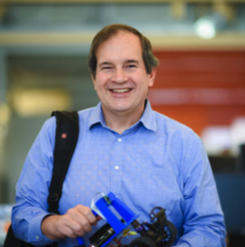
Presenter
Solution Architect
Author of ”Making Sense of NoSQL”
Interested in AI and Graph Knowledge Representations
Focus on helping business units adopt emerging technologies
Loves to build “mental models” of how organizations work
Using “Systems Thinking” since 1990
Dan McCreary
Distinguished Engineer
Optum Advanced Technology Collaborative

Slide 3
NoSQL Architectural Patterns
Relational
Analytical (OLAP)
Key-Value
key
value
key
value
key
value
key
value
Column-Family
Graph
Document

Slide 4

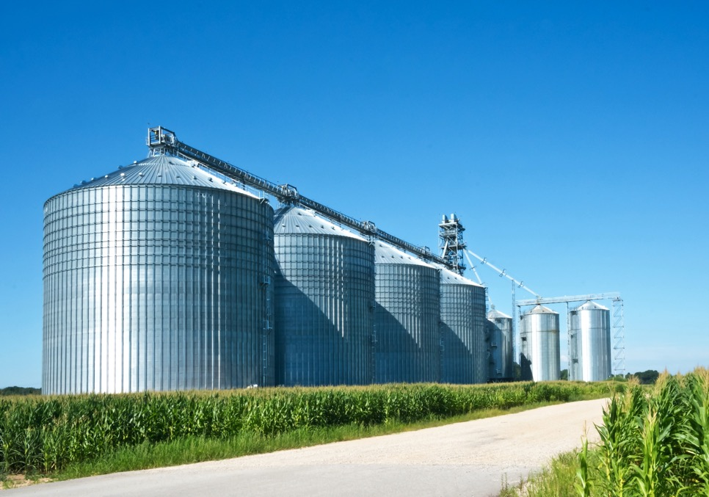
Borderless Codevelopment – how do we “tear down barriers”
Systems Thinking
Siloed Thinking and Siloed Systems

Slide 5
What Is Borderless Codevelopment?
What Is Systems Thinking?
Systems Thinking Concepts
Archetypes for Technologists
Borderless Innovation for Architects
https://systems-thinking.optum.com
Notes:
In this session, we’ll introduce you to the technology, how it works, when should it be used and a few real world use cases for health care.

Slide 6
What is Borderless Codevelopment?
Optimizing development for for the entire organization, not a subset

Slide 7

Andrew Witty on Silo Behavior
Fireside Chat on Feb. 22nd, 2022
It’s the job of every employee in the company to call out silo behavior, where people are prioritizing their local interests above and beyond the benefit, or the opportunity for the whole company, and of course, for our customer.

Slide 8
Bounded Positive Intent
Organization
Business Unit
Division
A focus on optimization at any of the levels below the organization level, putting a lower focus on how these decisions impact our members user experience.
“Suboptimzation”
Department
Bounded
Rationality
Team

Slide 9
One Company – Many Siloed Computer Systems
System
System
System
System
System
System
System
System
System
System
How much effort should we put on integrating these discrete systems?

Slide 10



Top Three Manifestation of Siloed Behavior
Poor User Experience
Poor Predictions
Poor Sharing of Great Ideas

Slide 11

Many Other Downsides of Siloed Behavior
Longer call times for our members, providers and employees
Siloed data that requires call center staff to login to many systems
Data scientists that don’t have enough high-quality connected data to make good predictions
Analytics that don’t take other systems data into account
Inconsistent views of costs
Little reuse of code
Duplication of effort
Blockers to innovation

Slide 12
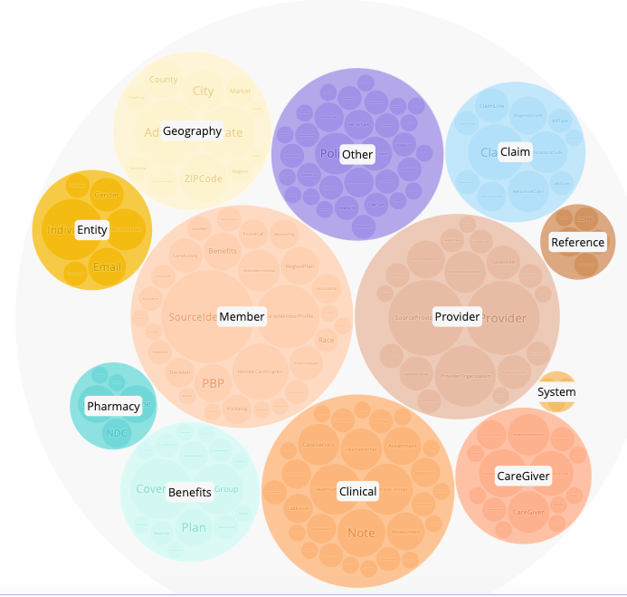
Integration is Hard!
Multiple business areas of a company
Different representations of the same data
Difficult to match and connect incomplete data
High cost to move data between systems in real-time
Source systems subject-matter-experts needed to interpret data
NPS
Reference: https://metagator.optum.com/schema

Slide 13

Are We Building Connected Heathcare?
The word “connected” appears 12 times in the 2020 UnitedHealth Group Investor Conference Book.
https://www.unitedhealthgroup.com/viewer.html?file=/content/dam/UHG/PDF/investors/2020/investor-conference/IC20_Book.pdf
Notes:
https://www.unitedhealthgroup.com/viewer.html?file=/content/dam/UHG/PDF/investors/2020/investor-conference/IC20_Book.pdf

Slide 14
Centralized vs Decentralized Control
Central Control
Decentralized Control
Business
Unit
Business
Unit
Centralized
IT Decision
Business
Unit
Business
Unit
IT decisions are made in a centralized IT organization
Example: Centralized security policy
Example: Amazon – centralized dictates on sharing data
See Steve Yegge's Platforms Rant
IT decisions are made by individual business units
Acquired companies frequently have their own IT infrastructure that is incompatible with other acquired organizations
This makes it hard to share data
Notes:
Example from Amazon – Steve Yegge Platform
https://gist.github.com/chitchcock/1281611
https://www.youtube.com/watch?v=xDdkc_RwKYI

Slide 15
Conway’s Law
Any organization that designs a system will produce a design whose structure is a copy of the organization's communication structure.
Dept A
Lib A
Dept B
Dept C
Lib B
Lib C
Dept D
Dept E
Lib D
Lib E
Corollary: The structure of our code and data will tend to reflect our our org chart, not what is ideal for serving our customers!

Slide 16
What is Systems Thinking?
A tool to break down siloed thinking

Slide 17
Systems Thinking Definition
Systems thinking is a holistic approach to analysis that focuses on the way that a system's constituent parts interrelate and how systems work over time and within the context of larger systems.
A Definition of Systems Thinking: A Systems Approach
Ross D. Arnold and Jon P. Wade
https://www.sciencedirect.com/science/article/pii/S1877050915002860

Slide 18
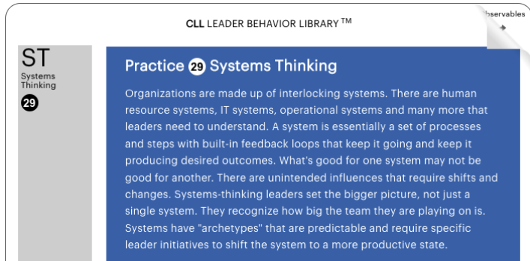
Systems Thinking is Part of the CLL Leadership Behavior Library
CLL = Common Language of Leadership
Key phrases: feedback loops, suboptimization, unintended consequence, archetypes, leadership required to shift states

Slide 19

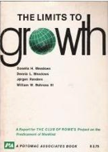


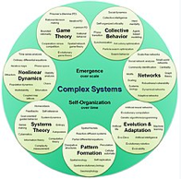
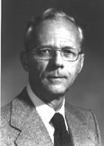
Key Milestones Since 1956
Jay Forrester
Donella Meadows
Limits to
Growth
The Fifth
Discipline
Thinking in
Systems
Complex
Systems
In 1956 Jay Forrester (co-inventor of core memory) promoted the idea of “System Thinking” in the Systems Dynamics Group at MIT’s Sloan School.
In 1972, Inspired by Forrester, the book Limits to Growth was published by Donella Meadows and others. It used Systems Thinking to look a human-earth interactions and created simulations based on these observations.
In 2006, Peter Senge wrote “The Fifth Discipline” which positioned Systems Thinking as a core element of business strategy.
In 2008, Donella Meadows work on “Thinking in Systems” was published and promoted Systems Thinking as a general problem-solving discipline and encouraged it to be part of any critical thinking training.
Systems Thinking is now considered a part of Complex Systems (Wikipedia).
https://en.wikipedia.org/wiki/Systems_theory#History

Slide 20
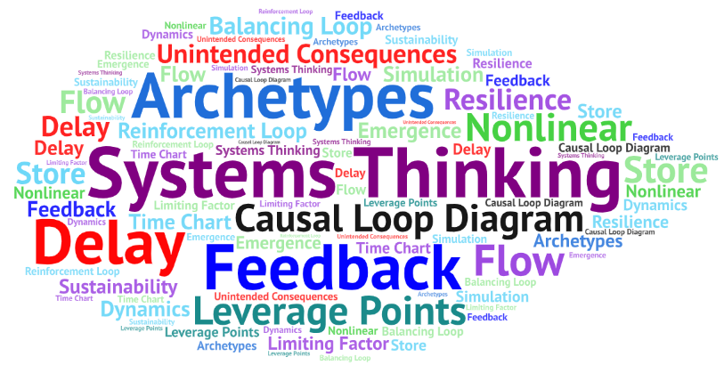
Systems Thinking Terminology
https://systems-thinking.optum.com/glossary/

Slide 21
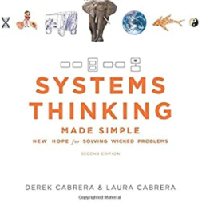


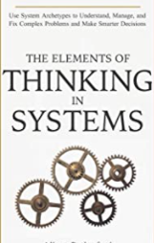

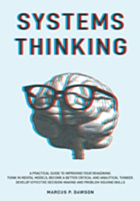




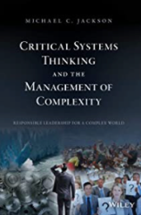

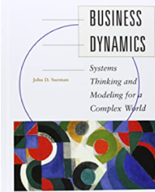
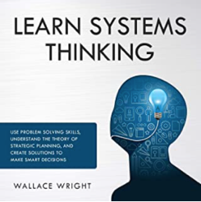


Over 20 Years of Established Best Practices
Don’t be intimidated!
Systems Thinking really is about a dozen core concepts
Most people can learn the basic principals of Systems Thinking in a few days

Slide 22
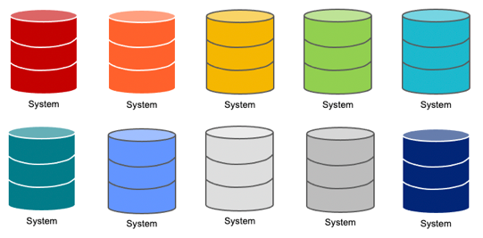
Project Silos vs Systems Thinking
Isolated Silo View
Systems Thinking View
Each project is an independent silo of effort
The success of any project will not impact the success of other projects
Project order is not relevant and project value is static in time
Project costs and benefits are easy to represent in a simple spreadsheet
Each project has their own team and their own backlog
Projects are dependent on another project success
The success of foundational projects may have a dramatic impact on other projects (x10 faster)
Project order is relevant and deferring customer benefit is needed until foundational projects are complete
Requires a deep understanding of how resources created by one project can be leveraged by other projects (reuse)
Extensive use of shared backlog of tasks

Slide 23
Search and Reuse
You can’t reuse what you can’t find
If you can’t find it, you will duplicate it… in a new silo
If you duplicate it, you will defend your silo
Great internet search prevents silos from ever being created!

Slide 24
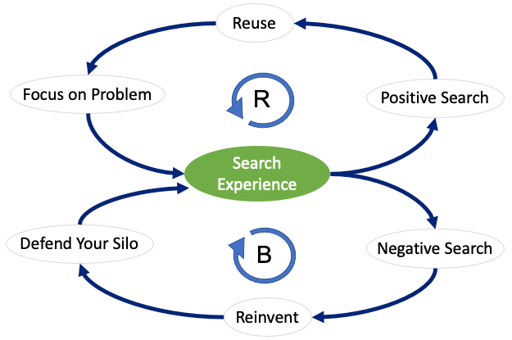
Search Causal Loop Diagram

Slide 25

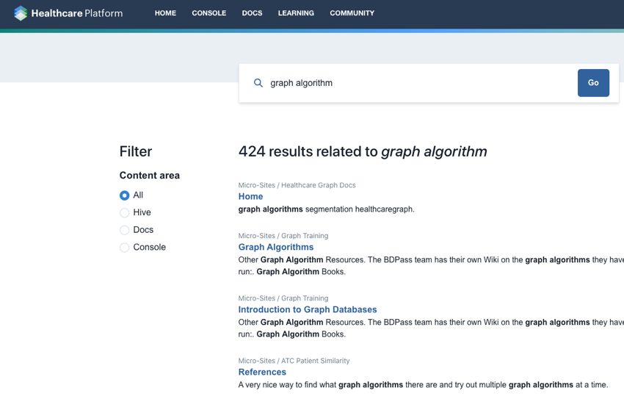
Search and Reuse
Promote search and reuse through microsite publishing
Any GitHub site can be turned into a microsite
Any changes to the documentation will immediately be reindexed
Example: Healthcare Platform Search
https://hcp.uhg.com/

Slide 26
Connected Data Strategy
Connected Data Strategy: An Enterprise Data Strategy pattern that brings focus to the business value of connecting disparate silos of data.
How much value?
At what cost?
$
$$$$
Lower Value
Higher Value

Slide 27

Unconnected Data is a Liability
Kendall Clark
https://www.stardog.com/blog/unconnected-data-is-a-liability

Slide 28


Systems Thinking is NOT
a programming technique
a certification you can get
a silver bullet to all our integration problems
Systems Thinking is a type of critical thinking that helps us break down siloed thinking.

Slide 29


What exactly is “A System”?
A collection of components that interact together to produce some sort of behavior of the whole
Systems can have subsystems
Systems can be part of other systems
Dynamic systems have feedback

Slide 30
Data Flow Diagrams (DFD) vs. Causal Diagrams
Data
Warehouse
Source
Data
ETL
Job
Data
Rain
Wet
Grass
Causes
Data Flowing Between Systems
Direction on arrows
Causal Relationship
Direction is also relevant
but may not be “data”

Slide 31
Linear (static) vs Circular (dynamic)
A
B
C
A
B
C
Static Causal Analysis
Dynamic Causal Analysis
with Feedback
Causal Loop Diagram (CLDs)

Slide 32
Warning! Don’t Confuse Data Flows with Causality
DFD != CLD
Many great architects have strong skills drawing data flow diagrams!
Very few architects have formal training in creating causal diagrams.

Slide 33




Example: The AI/ML Flywheel
Data
Creates
Use to build
Feedback
Machine Learning Model
Can gather
Use to make
Prediction
Feedback creates more data which creates more precise machine learning models.

Slide 34
Causal Loop Diagrams (CLD)
Positive
Feedback
Loop
R
Reinforcing
Loop
Current
State
Negative
Feedback
Loop
Balancing
Loop
B
Primary tool for facilitation of discussion of feedback cycles.

Slide 35
Systems Thinking Archetypes
An ideal example that illustrates systems thinking.

Slide 36
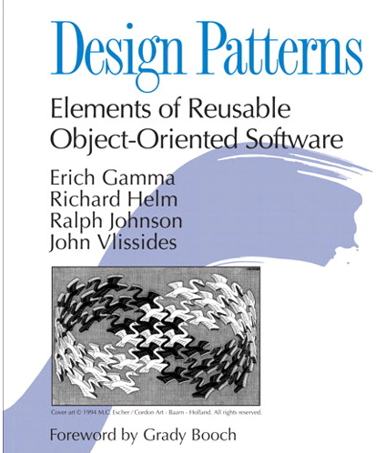
What is a Systems Thinking Archetype?
Design Patterns for Systems Thinkers
Archetypes are to Systems Thinking what Patterns are to software design.
A small set of system structures that produce common behavioral patterns across many different fields.
Used to teach Systems Thinking concepts

Slide 37
Sample Archetypes for Technologist
The Tragedy of the Commons – Share resources and scalability
Metcalf’s Law - Network Effects and standards
The AI Flywheel – Data, models, prediction and feedback
Search and Reuse – You can’t reuse what you can’t find
Database Model Precision – Model shareability across systems
The Enterprise Knowledge Graph – Scalable shared knowledge

Slide 38




Tragedy of The Commons
Farmer Brown
Farmer Smith
Farmer Cooper
The Commons
Farmer Jones
Farmer Baker
Farmer Anderson

Slide 39
Tragedy of The Commons
A situation in economic science when individual users, who have open access to a resource unhampered by shared social structures or formal rules that govern access and use, act independently according to their own self-interest and, contrary to the common good of all users, cause depletion of the resource through their uncoordinated action.
https://en.wikipedia.org/wiki/Tragedy_of_the_commons
The more everyone uses a resource, the less valuable it becomes.

Slide 40
Causal Loop Diagram for Individual Farmer
+
Delay
Fatten Cows
Delay
Get More Cows
R
Use “Free” Commons
+
Cows in
Herd
Reinforcing Loop

Slide 41
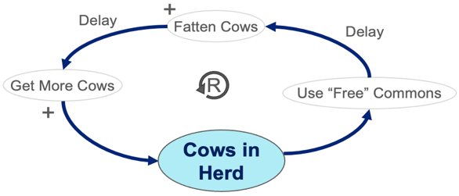

Total Activity And Resource Limit
B
Total Activity
Total
Gains
Delay
Resource
Limited!
B

Slide 42
Utility is a Non-linear Function of Usage
Usefulness to
all Farmers
Overgrazing Point
Uselessness
Collective Usage

Slide 43







Databases are Also Shared Resources
Marketing
Product Development
Sales
The Scale-Out Enterprise Database
Customer Support
Information Technology
Research

Slide 44
Query Response vs. Time of Day
Average Query Response Time in Seconds (M-F)
10
Lunch
5
2
Time of Day
Midnight
8 am
Noon
5pm
Many users fighting for a shared resource with limited capability
The more you use it the lower the value to others
Confidential property of Optum. Do not distribute or reproduce without express permission from Optum.

Slide 45
Causal Loop Diagram for Single Business Unit
+
Delay
Strategy
Quartey
Financial
Statements
R
MBOs
+
Profits and
Growth
Reward Executives for Profits and Growth
only within their own Business Unit.

Slide 46
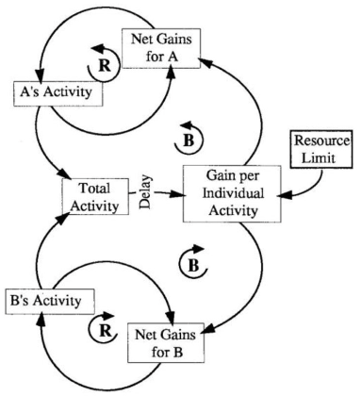
Multiple Users of Any Limited Shared Resource
Modern B/R notation from diagrams by Peter Senge

Slide 47

Metcalfe’s Law (Network Effect)
The value of a telecommunications network is proportional to the square of the number of connected users of the system (n²).
Value
https://en.wikipedia.org/wiki/Metcalfe%27s_law
Number of Devices
The more everyone uses a standard, the more valuable it becomes.

Slide 48
Network Effects (Metcalfe’s Law)
The value of any device on a network standard grows exponentially as the number of connections increase.
Lower Cost Per Device
Higher Adoption
More Devices
Manufactured
R
Increased Use
Higher Adoption
Networking
Standard
Decreased Use
Lower Adoption
Use Alternate Standards
B
Users Can’t Communicate
High Cost Per Device

Slide 49
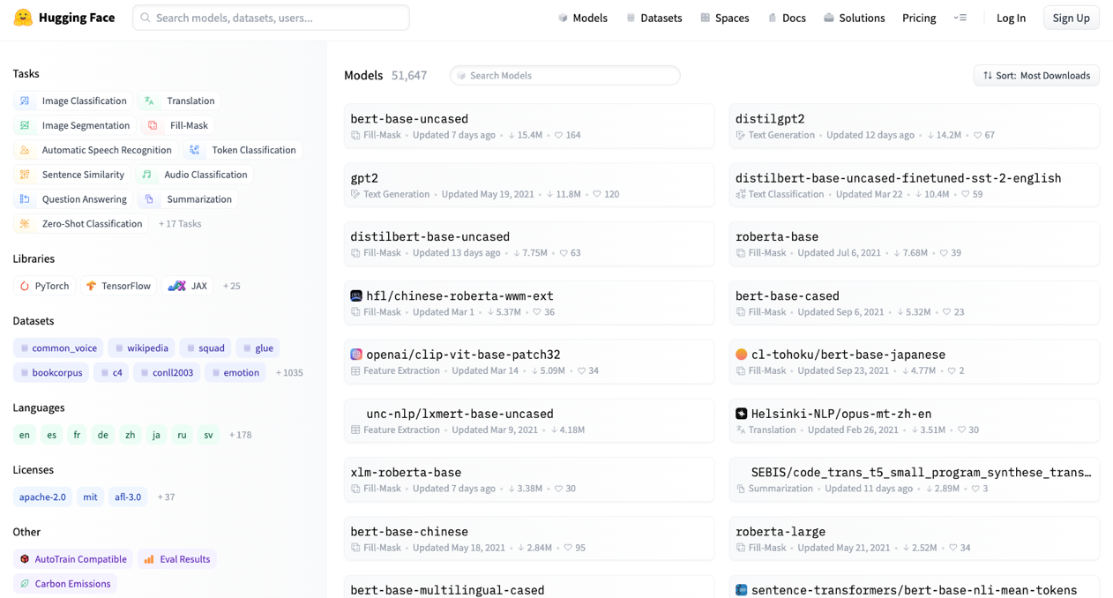
HuggingFace - $2 Billion Evaluation in 5 Years!
51K machine learning
models in June 2022
R

Slide 50
Connected Data Strategy
How much value?
At what cost?
Higher Value
$$$$
Lower Value
$
Connected Data Strategy: An Enterprise Data Strategy pattern that brings focus to the business value of connecting disparate silos of data.
Confidential property of Optum. Do not distribute or reproduce without express permission from Optum.

Slide 51
20 Silo Bridging Ideas
20 little ideas to help us become a customer-centric company

Slide 52
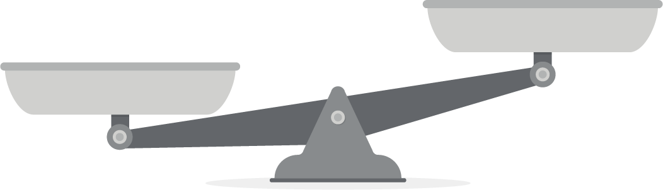
Goal: Objective Weighing of Pros and Cons
Graph Cost
New Insights
Kafka Streaming Cost
Easy to measure
Hard to measure
CDC Cost
Data Science
Productivity
Member Journey
Cons
Pros
We are starting to learn the benefits of connected data: Customer 360
It takes time and effort to create high-quality connected data
Can we objectively measure each of the pros and cons?
What is the value of “new insights?”
How is our decision making driven by what is easy to measure?

Slide 53
Product Recommendation Engine Causal Loop Diagram
Additional
Purchases
Right Products Fast
Additional
Revenue
Great Recommendations
Increases
Member NPS
No New
Revenue
Poor Recommendations
Decreases
No
Purchases
Wrong Products Slowly
NPS = Net Promoter Score Likelihood to recommend Optum Store?

Slide 54


Customer Support Chatbot
Chat Log
Creates
Use to build intent detection model
More feedback is used to build better intent detection models.
Feedback
Machine Learning Model
Did that answer your question?
Attempt to answer question
Chatbot Answer

Slide 55
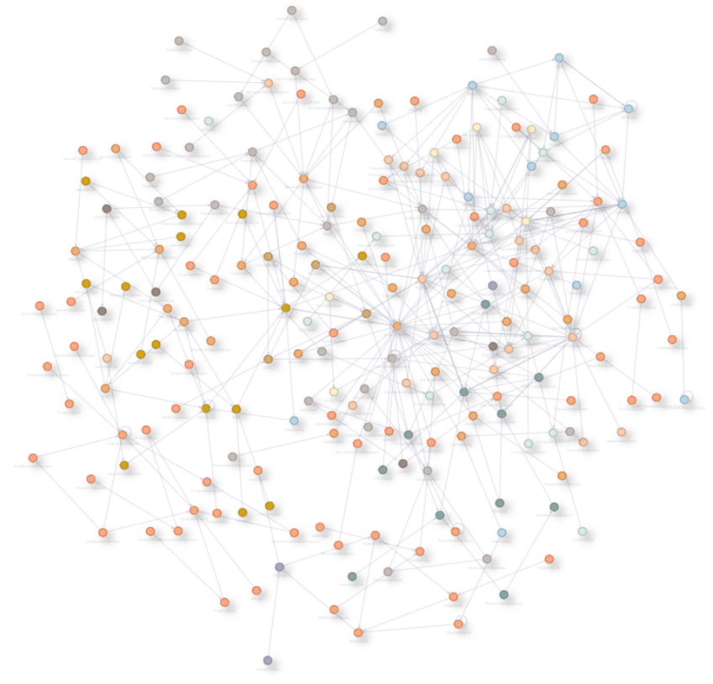
Healthcare Data Model Precision and Cost Sharing
Healthcare Graph
Data Model
212 Vertices
600+ Relationships
https://metagator.optum.com/schema

Slide 56
Data Model Precision, Completeness and Cost Sharing
Higher Sharing of EKG
Cost Savings
Precise Data Agreement
Precise and complete data models allow multiple business units to share EKG infrastructure costs.
More
High Quality
Data Model Precision
Less
Low Quality
Duplication and Higher Costs
Poor Data Models
Constant
Rework
“We just modeled our graph data just like our RDBMS to minimize joins.”

Slide 57
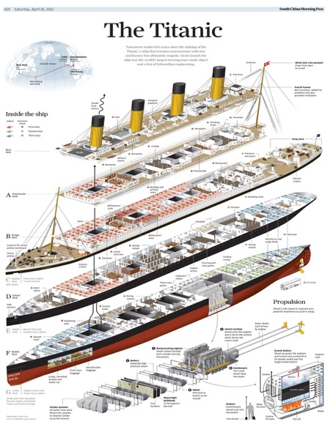
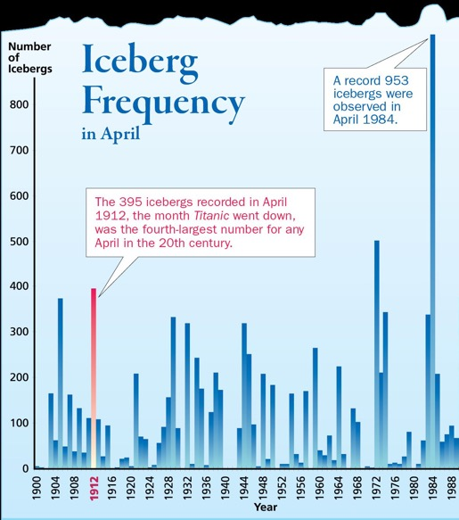
Modeling Precision
“All models are wrong. Some models are useful.” - George Box
Graph data models are better at modeling the real world.
Models that are correct are easily shared across business units.

Slide 58
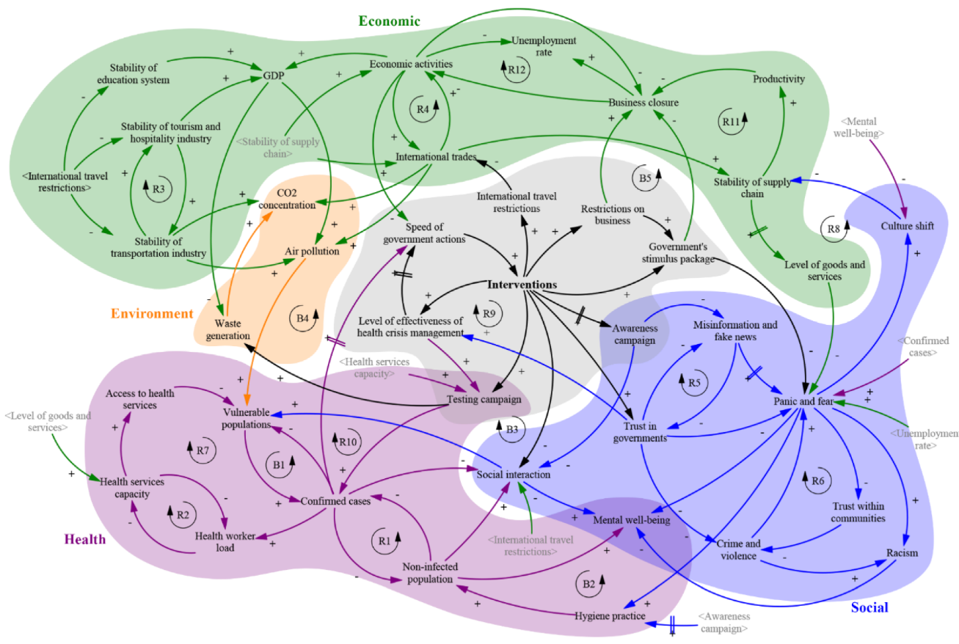
CLD for COVID-19
https://www.mdpi.com/2079-8954/8/2/20

Slide 59
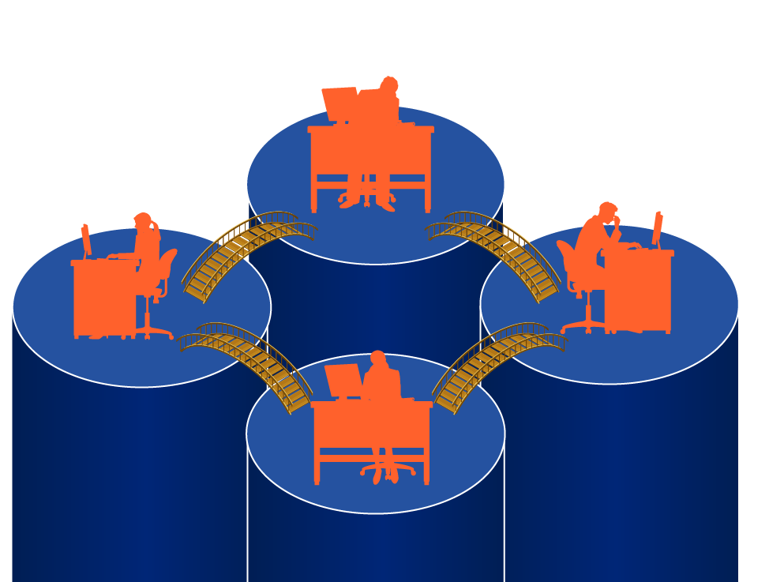
Bridging Silos
Busting
A better metaphor for collaboration?

Slide 60
20 Borderless Innovation Micro-initiaves for Architects
Call out siloed behavior and suggest a solution based on Systems Thinking
Think deeply about how our decisions impact our customer/member experiences
Remember that the more connected data we have, the better our ML models will be and the better our recommendations
Read a book on Systems Thinking (see me for suggestions)
Learn how to draw Causal Loop Diagram (I have PPT and Miro templates), Google “Causal Loop Diagrams”
Make your GitHub repo PUBLIC. - Use Hashicorp Vault to store secrets
Make your code searchable on HCP with Microsites
Create a useful README so that other teams can quickly use your code and tag reusable assets
Write a good “Getting Started” guide to encourage others to reuse your code
Reward reuse and discourage reinvention
Search GitHub and HCP before you create something new (look left, look right, go forward)
Consider Open Source before you create new code
When you see multiple groups building the same tools, build collaborations
Build systems that scale for future users
Promote data sharing so data scientists can build better predictive models
Encourage high-quality publishing of data dictionaries (semantics and metadata)
Promote data standards and data stewardship
Look for ways to build bridges between teams building duplicative services
Take a course on Systems Thinking
Join a discussion group on Systems Thinking

Slide 61
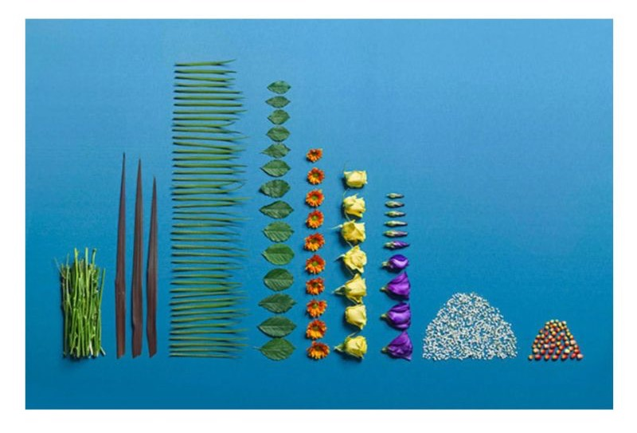

There is Beauty in Systems That Serve Our Customers!
Siloed Thinking
Systems Thinking
The Art of Clean Up: Life Made Neat and Tidy by Ursus Wehrli

Slide 62
Q&A

Slide 63



ATC website: http://atc.optum.com
Dan.McCreary@gmail.com
https://www.linkedin.com/in/danmccreary
https://dmccreary.medium.com/
@dmccreary

